Slide 1



Factors for picking a University and Degree
A Data Analysis using Numpy and Matplotlib
By Andrew Poh
Notes:
Good morning Mr Seah. I am Andrew and I will be presenting to you a data analysis regarding factors for picking a university and degree.

Slide 2
Table of contents
01
02
Scenario
Datasets
03
04
Analysis
Recommendation
Notes:
These are the 4 main things I’ll be covering in this presentation

Slide 3

01
Scenario
Notes:
We’ll start off with the scenario

Slide 4

Scenario
Problem Statement: Which university and degree should a student pick?
Mark is a polytechnic student who wants to enroll in a university, but does not know which university or course to pick.
No interests/hobbies
Wants guaranteed employment
Wants high pay
3.6 GPA
Notes:
My analysis aims to answer the following problem statement: Which university and degree should a student pick?
I will be using a specific scenario to guide my questions. In this scenario, we will be looking through the lenses of a polytechnic student named Mark who wants to enroll in a university, but does not know which university or course to choose. He does not have any particular interests, but wants a career with guaranteed employment with the highest possible pay. He is slightly worried about not being able to graduate as his performance in school is slightly above average with a GPA of around 3.6.

Slide 5
Scenario
1.
Which university and degree graduates have the best immediate career prospects?
Pay and Employment
2.
Which universities and degrees are realistic based on a student's ability/preferences?
Past graduation rates, Popularity of courses and Difficulty of enrolling
Notes:
I have split the problem statement into 2 key questions.
Firstly, which university and degree graduates have the best immediate career prospects?
Secondly, which universities and degrees are realistic based on a student’s ability/preferences?

Slide 6
02
Datasets
Notes:
Now I’ll briefly go over the datasets used

Slide 7
Datasets
Graduate Employment Survey
ges.csv
Intake, Enrolment and Graduates by Institutions
IntakeByInstitution.csv and GraduatesByInstitution.csv
Universities - Intake, Enrolment and Graduates by Course
UniversitiesIntakeEnrolmentandGraduatesbyCourse.csv
NUS Indicative Grade Profile
NUSigp.csv
Notes:
Here are the 4 datasets used in the analysis. The second dataset was split provided in 3 different csv files and I used 2 of them, but they still work together as just 1 dataset. Hence there are 5 csv files in total but only 4 datasets.

Slide 8
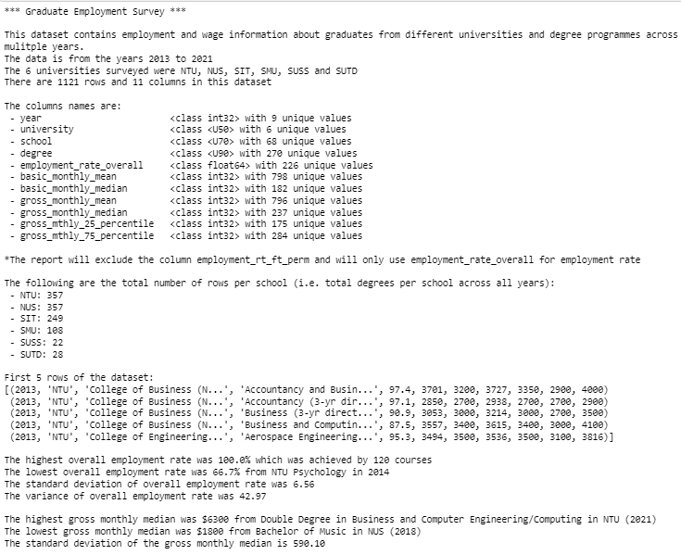
Datasets
Data extracted using Numpy
Notes:
Key details of each dataset are extracted using Numpy in the Jupyter Notebook report such as number of rows and columns, max and mins, standard deviation etc. This here is just an example of the Graduate Employment Survey Dataset

Slide 9
03
Analysis
Notes:
It’s time to go through the analysis itself. The first half of the analysis will answer the first key question: Which university and degree graduates have the best immediate career prospects?

Slide 10
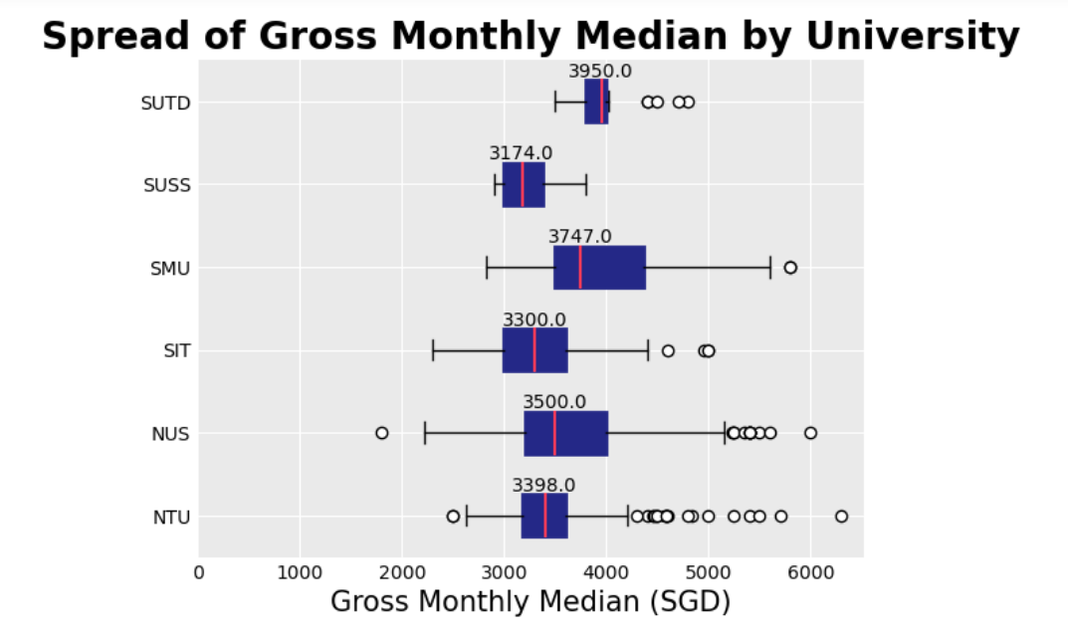
Analysis (Wage)
Notes:
First off, I have used a boxplot to get a high level overview of the gross monthly median wage of graduates from each university. My initial intent was to compare the universities medians and interquartile ranges to see which university’s graduates get paid better. However, we can see that universities such as SMU and NUS have a very wide range of wages. This led me to realise that this comparison would not be fair as wages largely depend on the courses that the student takes within the university. Hence, I needed to compare the universities across 1 fixed degree for a better comparison.

Slide 11
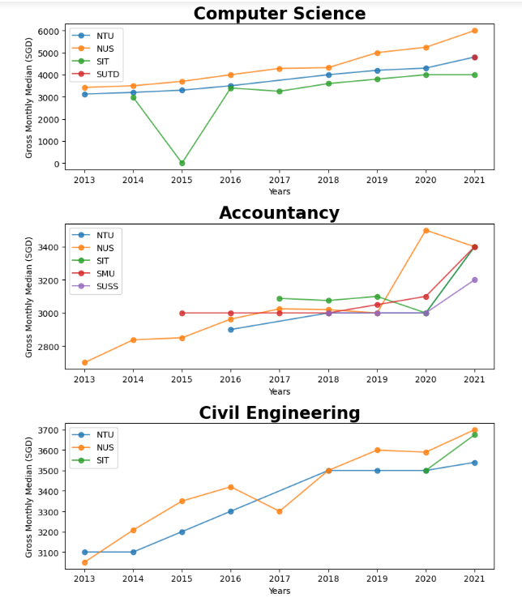
Analysis (Wage)
Notes:
With this in mind, I used a line graph to compare the gross median wages of the universities graduates across the years 2013 to 2021 for these 3 courses. There were no courses that all 6 universities offered equivalents for, so these 3 were the ones that would allow for comparison of the most universities.
From the Computer Science graph, we can see that the average NUS Computer Science graduate has consistently received higher pay then the average NTU Computer Science graduate, followed by SIT graduates. The only outlier is SIT 2015, however that is due to the SIT 2015 data being 'na' and thus resulting in a 0. This can be ignored.
From the Accountancy graph, we see that the average Accountancy university graduate pay has fluctuated over the years. SMU graduates were the highest paid in 2016, SIT was the highest from 2017 to 2019, NUS suddenly spiked to the highest at SGD3500 in 2020 while in 2021 NUS SMU and SIT all have the same median wage of SGD3400.
From the Civil Engineering graph, we can see that the average NUS Civil Engineering graduate was generally paid more than the average NTU Civil Engineering graduate with the exception of the year 2017.
What we can derive from this information is that the university with the highest paid graduates isn’t always consistent across all degrees like we can see in Accountancy. However, if Mark is interested in Computer Science and Civil Engineering specifically, NUS grads are the top paid.

Slide 12
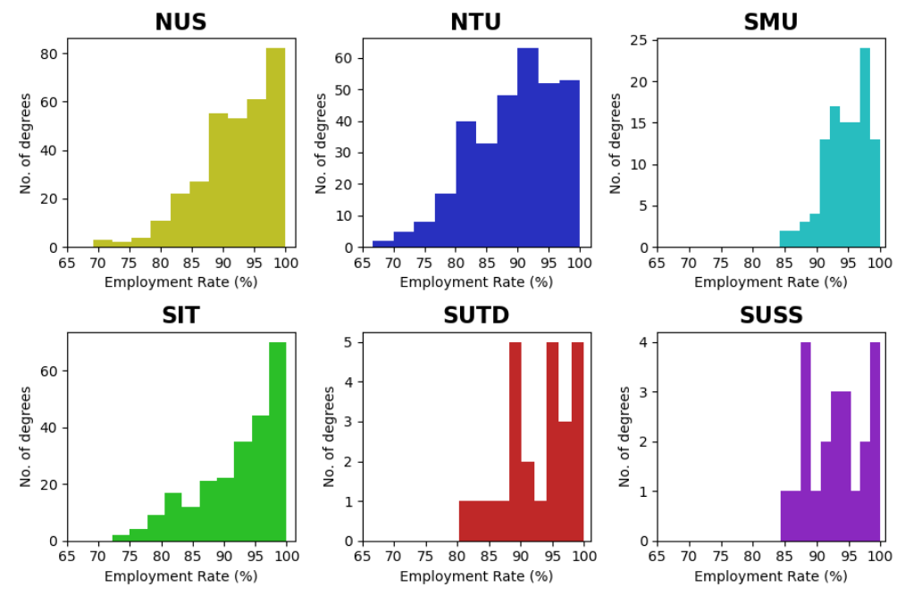
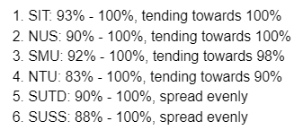
Analysis (Employment)
Notes:
Next we must compare employment by university. I used a histogram to plot the number of degrees against the employment rate of each degree to show how many of each degree fall within a certain employment rate range.
In general, employment rates of degree holders are fairly high, with most degree graduates have an employment rate between 80% to 100%.
On the right, I have ranked the universities according to where the bulk of their employment rate falls under.
SIT is first with the bulk of their courses falling under 93% - 100%, tending towards 100% employment rate, followed by NUS and so on.
Since one of Mark’s concerns is guaranteed employment, he should consider a university like SIT or NUS which historically have higher graduate employment rates.

Slide 13
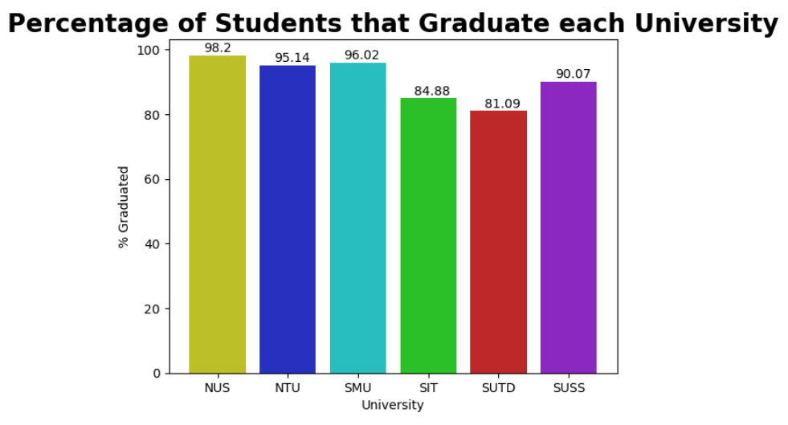
Analysis (Graduation Rate)
Notes:
Now the next half of the analysis will answer the second question: Which universities and degrees are realistic based on a student's ability/preferences?
We’ll first look at the graduation rates of each university. This bar chart shows the graduation rate of all universities calculated using the intake batch of 2016 and the graduating batch of 2020. From this, we can see that NUS has the highest graduation rate of 98.2% followed by SMU and so on. Thus, if Mark is worried about not being able to graduate, he should pick a university such as NUS, SMU or NTU which have high graduation rates above 95%.

Slide 14
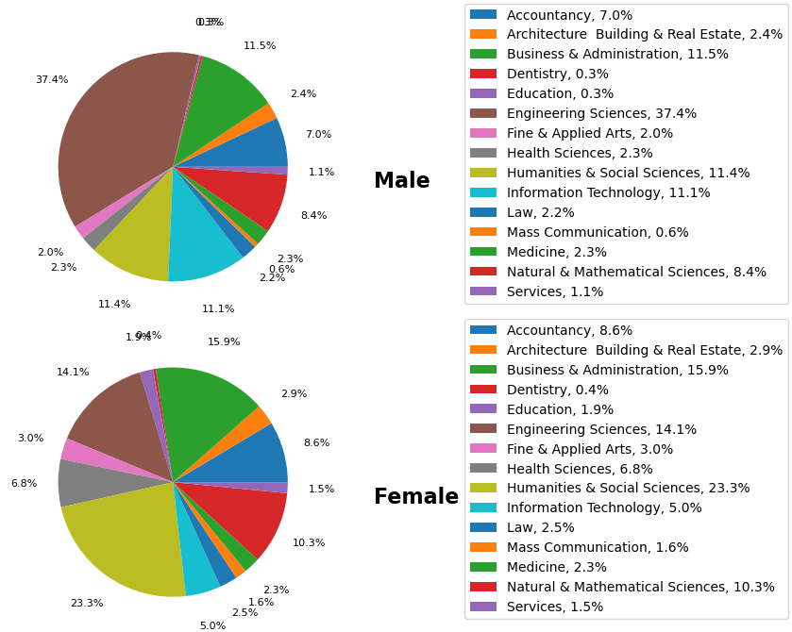
Analysis (Course Popularity by Gender)
Notes:
I now want to see which courses are popular among each gender. From this pie chart, we can pick out some of the more popular courses per gender.
For males, Engineering Sciences is the most popular course which makes up 37.4% of male graduates. This is followed by Business & Administration with 11.5%.
For females, Humanities & Social Sciences is the most popular course which makes up 23.3% of female graduates. This is followed by Business & Administration with 15.9%.
In Mark’s case, since he is male but has no particular interests, he could see what courses are popular amongst other males which seems to be Engineering Sciences and Business Admin.

Slide 15
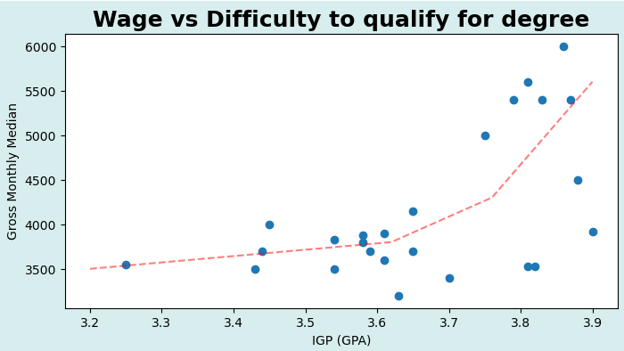
Analysis (Difficult of qualifying for course)
Notes:
Finally, as much as a student wants the best pay, we must consider the student’s ability. This scatter plot shows the NUS Indicative Grade Profile for each course compared with its gross monthly median wage. The red line show the general trend of the IGP which seems to climb exponentially. Seeing as Mark’s GPA is around 3.6, he should be looking for the highest monthly median within the 3.5-3.7 range. The highest point in that range is at SGD4150 circled in green which belongs to the degree.

Slide 16
04
Recommendation
Notes:
With all the data analysed, we can see which university and degree best fits Mark’s needs

Slide 17
Recommendation
1.
Which university and degree graduates have the best immediate career prospects?
Pay and Employment
2.
Which universities and degrees are realistic based on a student's ability/preferences?
Past graduation rates, Popularity of courses and Difficulty of enrolling
Notes:
Recalling the 2 key questions about the best career prospects and Mark’s own abilities, I have concluded that

Slide 18
NUS Engineering
Notes:
NUS Engineering would be the best option for Mark

Slide 19
Recommendation
Why Engineering?
Highest paid degree at 3.6 GPA (SGD4150)
Most popular degree among male students (37.4% of males)
Why NUS?
Second highest employment rate
Highest graduation rate
Notes:
Considering the Mark’s GPA of 3.6, the course that offers the highest gross monthly median at that GPA point is Engineering with SGD4150 at a GPA of 3.65. NUS has a very high employment rate compared to most of the other universities. NUS also has the highest graduation rate. The Engineering degree is also the most popular degree among male students. Hence, I would recommend Engineering in NUS.

Slide 20

Thanks!
Please keep this slide for attribution
Notes:
And with that, I have come to the end of the presentation. More details for the analyses can be found in the jupyter notebook report. Thank you.

